Slide 1

Returning To School During Covid-19
Westcliffe Federation

Slide 2

We have done a good job of social distancing and staying at home

Slide 3

Less people are getting sick with the Corona virus.

Slide 4
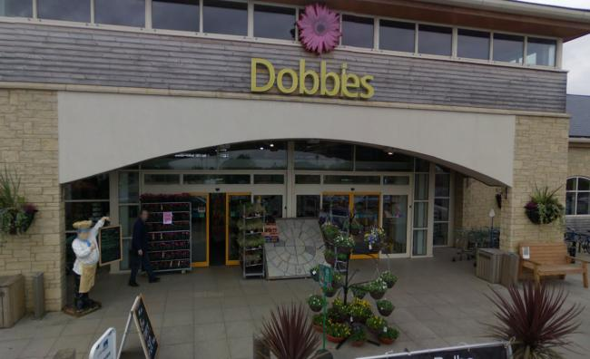
Some places will start to re-open gradually.

Slide 5
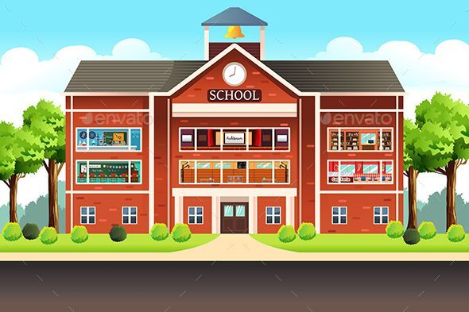
Schools are reopening soon

Slide 6
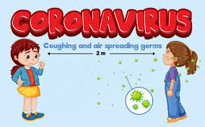
We need to be careful so that we don’t spread germs at school.

Slide 7

To keep everyone safe, things will be different at school.

Slide 8

Some children and staff will stay at home

Slide 9

Learning will take place at school for some children and online for other children

Slide 10
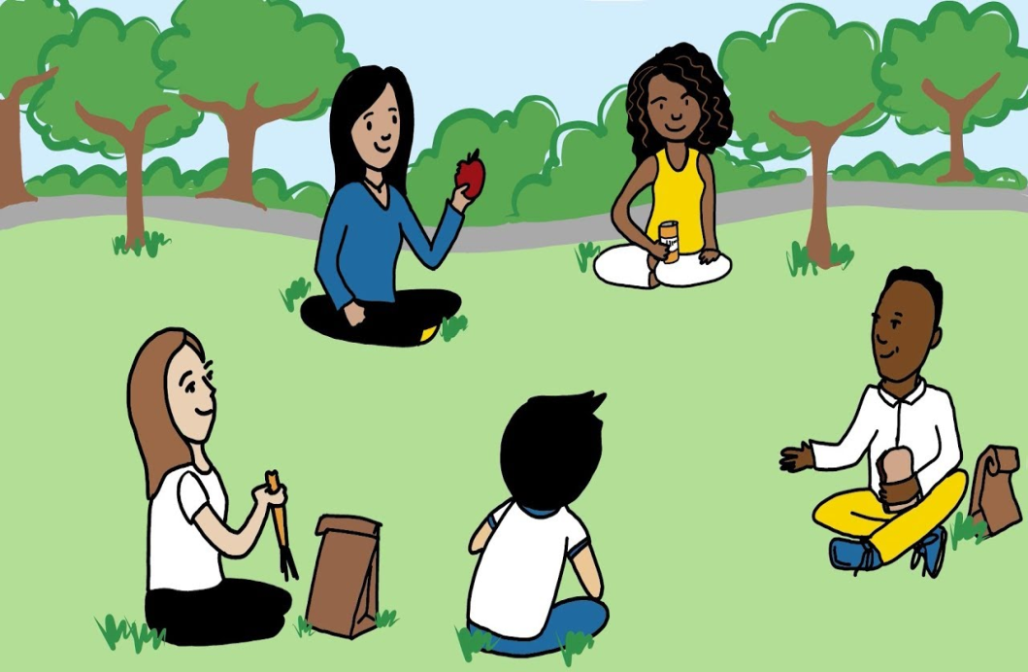
Children who come to school will attend in smaller groups

Slide 11

Children who come to school will attend at different times.

Slide 12
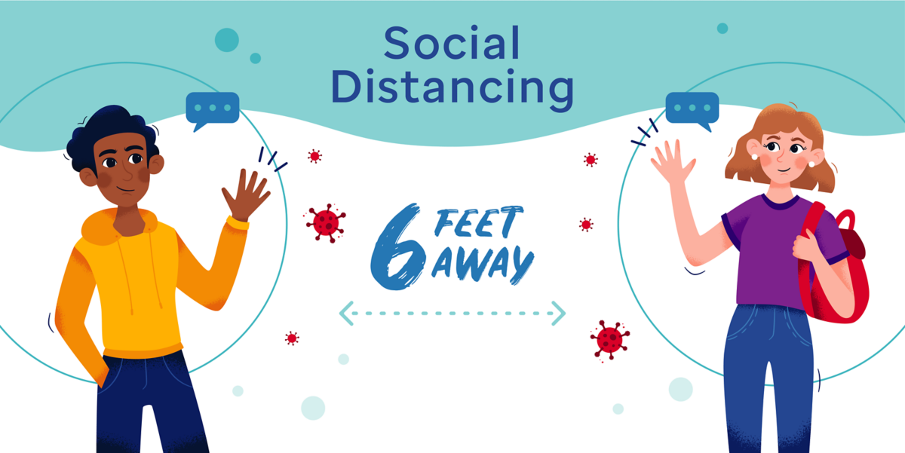
Parents might be asked to stay out of the building to limit the amount of people inside.

Slide 13

Everyone entering the school needs to make sure that they are healthy.

Slide 14
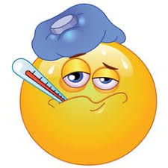
Anyone who is feeling sick needs to self-isolate at home so they don’t spread illnesses to anyone else

Slide 15

Some people might be wearing masks or gloves at school

Slide 16

Everyone that enters the school needs to wash their hands with soap for 20 seconds

Slide 17

Using hand sanitizer at school is also a good idea

Slide 18

The classrooms will look different

Slide 19

Many things will be put away

Slide 20

We will not be able to share books at school which will make us very sad

Slide 21
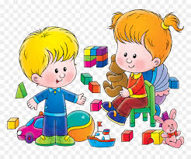
We will not be able to share toys at school

Slide 22

We will not be able to share resources at school

Slide 23
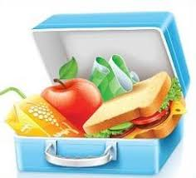
We will not be able to share food at school

Slide 24

We need to limit the things that we touch so that we don’t spread germs

Slide 25

We also need to physically distance ourselves from others at school

Slide 26

We will not be able to hug others or hold hands with others at school

Slide 27

The tables will be spread out, instead of in groups

Slide 28

Friends from other classes might not be outside at the same time

Slide 29
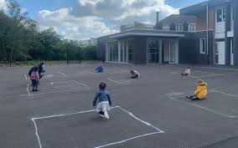
Our playgrounds will NOT look like this!

Slide 30

There will not be large gatherings at school, like assemblies

Slide 31

There are many things that we will be able to do at school and it will be lovely to be back at school

Slide 32
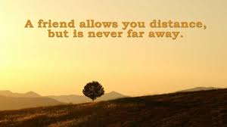
It will feel good to see some familiar faces and chat from a distance

Slide 33
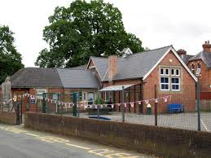
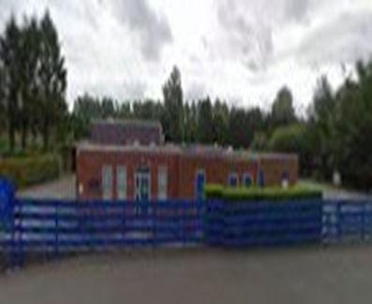
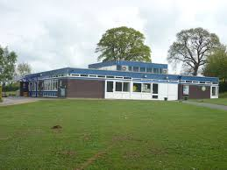
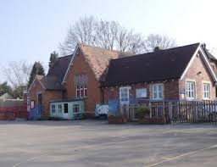
These changes at school are temporary. They will not last forever

Slide 34

For now, everyone needs to follow the safety rules and hopefully school will become more relaxed
We will be back together soon
We miss you and know how hard you have been working away from school
We are so very proud of each and everyone of you
Sending virtual hugs
Mrs Bond and the Westcliffe Team

